Slide 1

Build your first notification bot using Teams Toolkit for Visual Studio Code

Slide 2
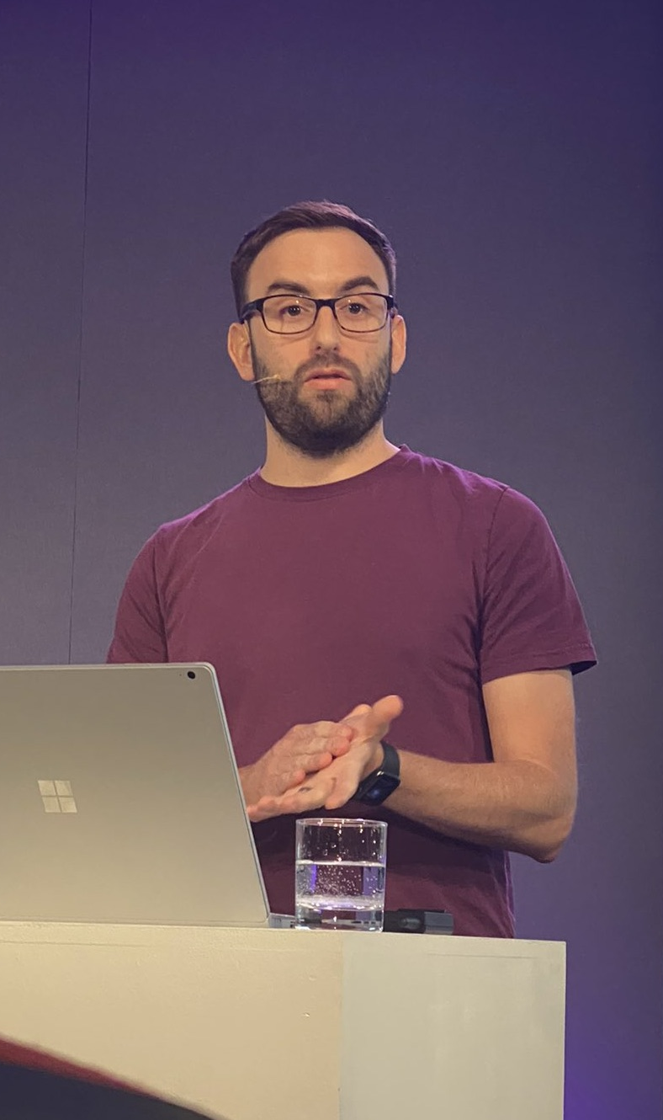
Profile Slide
Garry Trinder
💼 I work at Microsoft as a Senior Cloud Developer Advocate focused on Microsoft 365, where I help empower every developer on the planet to achieve more and to be successful with the Microsoft 365 platform
💻 I'm part of Microsoft 365 Platform Community (PnP) team where we help developers extend Microsoft 365 following best practices
⌨️ I co-maintain CLI for Microsoft 365 which is a cross-platform CLI to help manage Microsoft 365 tenants and SharePoint Framework projects
✍️ I share things on my blog (garrytrinder.github.io)
🎙 I talk about Microsoft 365 and the Modern Workplace on the GreyHatBeardPrincess podcast 🦡🎩🧔🏻👸
💬 Ask me about Microsoft 365 platform development
📫 You can reach me on twitter (@garrytrinder) or LinkedIn

Slide 3

Agenda
What is a notification bot?
Teams Toolkit for Visual Studio Code
Create your first project
Project overview
Running the bot for the first time
Triggering the bot
A look through the code
Summary
Resources

Slide 4

What is a notification bot?

Slide 5

Teams Toolkit for Visual Studio Code

Slide 6

Let’s build

Slide 7
Summary
1
2
3
Notification bots are great for sending pro-active messages into Microsoft Teams
Teams Toolkit provides the quickest way to get started developing Microsoft Teams apps
TeamsFX provides a layer of abstraction to simplify working with bot framework
Today we learned that…

Slide 8
Resources
Teams Toolkit
TeamsFX
Teams Toolkit Overview - Teams | Microsoft Learn
Create a new Teams app - Teams | Microsoft Learn
TeamsFx SDK - Teams | Microsoft Learn
OfficeDev/TeamsFx: Developer tools for building Teams apps (github.com)

Slide 9

Thank you

